Slide 1

AI BASED SOFTWARE MODEL FOR GENERATION AND PURIFICATION OF QUESTIONS IN QUESTION BANK

Slide 2
PROJECT GUIDE Wg Cdr Rahul Tripathi DS ,Faculty of AERO(L)
TEAM MEMBERS
Fg Offr Takhelmayum Paikhomba(214018-H)
Fg Offr Jawale Ojal Jitendra(214031-N)
Fg Offr Kunal Thakur(214014-N)
Fg Offr Preeti Yadav(214025-B)
Fg Offr Khandekar Vrushabh Vijay(214013-K)

Slide 3
PDC OF EVENTS
Learning of software - 10 Nov 24(completed)
Training of software - 10 Dec 24(completed)
Implementation - 21 Jan 25(pending)
Completion - 15 Feb 25(pending)

Slide 4
OBJECTIVE OF THE PROJECT
The objective of the project is to make an AI Based model for generation and purification of questions following the guidelines mentioned in IAP 5121

Slide 5
TYPES OF QUESTION
MCQ
TRUE OR FALSE
FILL IN THE BLANKS
SHORT ANSWER
LONG ANSWER

Slide 6
REQUIREMENT
HARDWARE
No special Hardware is required
SOFTWARE
Visual studio
Llama 3.2
Streamlit
Python Library

Slide 7

VISUAL STUDIO
Visual Studio is an integrated development environment (IDE) developed by Microsoft. It is used to develop computer programs including websites, web apps, web services and mobile apps. Visual Studio uses Microsoft software development platforms including Windows API, Windows Forms, Windows Presentation Foundation (WPF), Microsoft Store and Microsoft Silverlight. It can produce both native code and managed code.

Slide 8
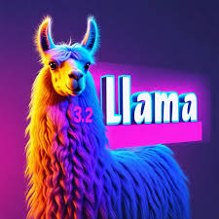
Llama 3.2
The Meta Llama 3.2 collection of multilingual large language models (LLMs) is a collection of pretrained and instruction-tuned generative models in 1B and 3B sizes (text in/text out). The Llama 3.2 instruction-tuned text only models are optimized for multilingual dialogue use cases, including agentic retrieval and summarization tasks.

Slide 9

STREAMLIT
Streamlit lets you transform Python scripts into interactive web apps in minutes, instead of weeks. Build dashboards, generate reports, or create chat apps. Once you’ve created an app, you can use our Community Cloud platform to deploy, manage, and share your app.

Slide 10

PYTHON lIBRARY
Streamlit: to act as a UI
Langchain:to run our program locally
Pdfminer:to extract text from pdf

Slide 11
METHODOLOGY
There are three input in the UI
Temperature
Pdf file
Maximum Chunk Length
Our AI model will analyze the data and generate the MCQ question
The output can be extracted from the UI

Slide 12
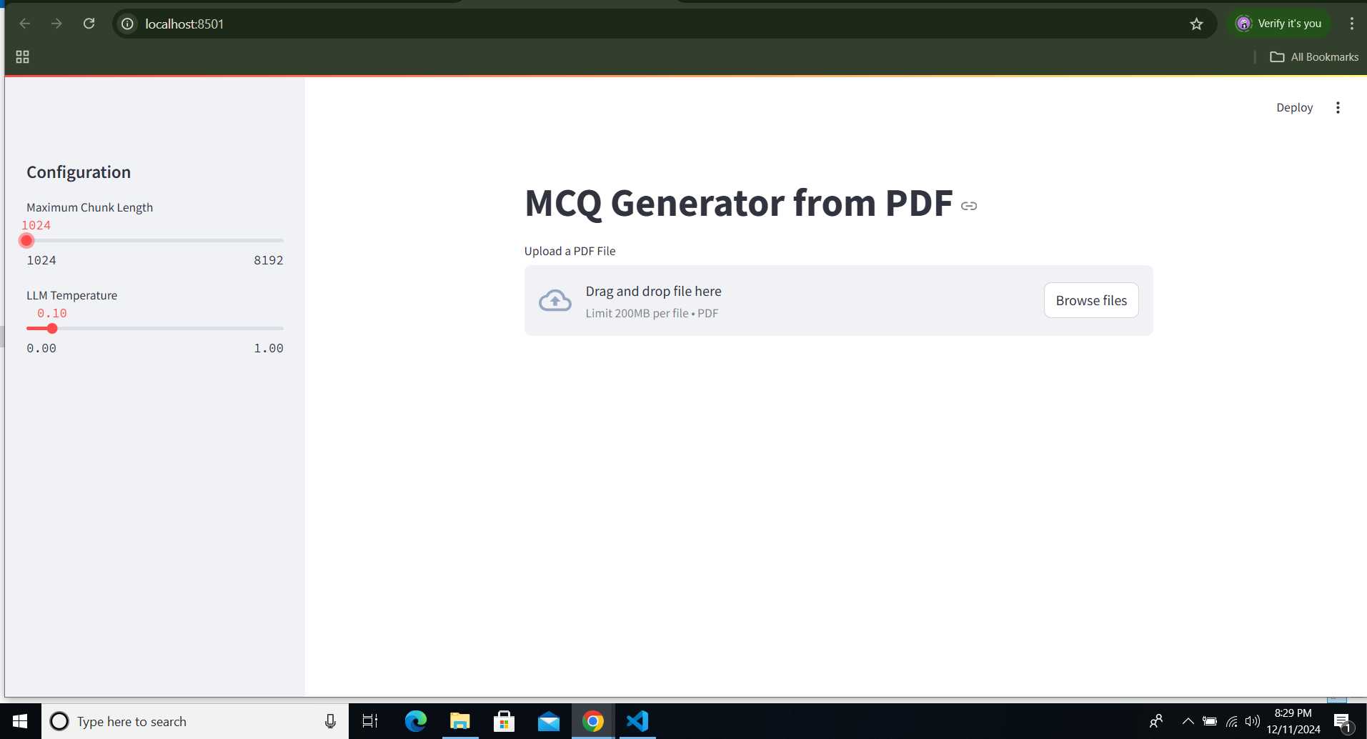
FRONT END(UI)

Slide 13
Temperature
In AI, temperature is a parameter that controls the randomness of an AI model's output. It's a numerical value that usually ranges from 0 to 1, but can sometimes be higher. The temperature setting affects how much risk the model takes when making choices.

Slide 14
Maximum Chunk Length
In AI, “Maximum chunk Length" refers to the length of a segment of text data that is processed at a time, essentially dividing larger documents into smaller, manageable units for analysis by a model, allowing for better comprehension and retrieval of information by balancing context preservation with computational efficiency; the optimal chunk size depends on the specific task and data type, with smaller chunks providing more granular detail while larger chunks offer broader context.

Slide 15
Pdf file
It will act as the data source for our AI model to generate the question.We are only focusing on the text part at this project

Slide 16
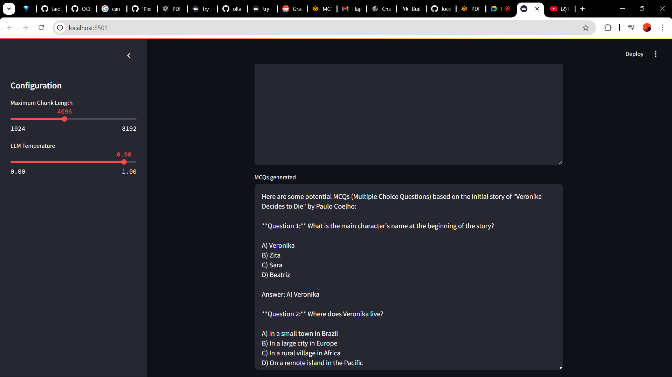
Generated MCQ

Slide 17
TASK LEFT
TRAIN OUR MODEL TO GENERATE OTHER TYPES OF QUESTION
UPDATE OF UI TO INTEGRATE THE OTHER TYPES OF QUESTION
USING PROMPT ENGINEERING TO GENERATE BETTER QUESTION

